Slide 1
Authors
Rufaida Butt
Ameena Adaam
Ebtisam Al-Malki
Bodor Al-Zahrani
Myasem Mahjub
Wejdan Al-Barnwi
Supervisor
Dr.olfat Mirza

Slide 2
Introduction

Slide 3
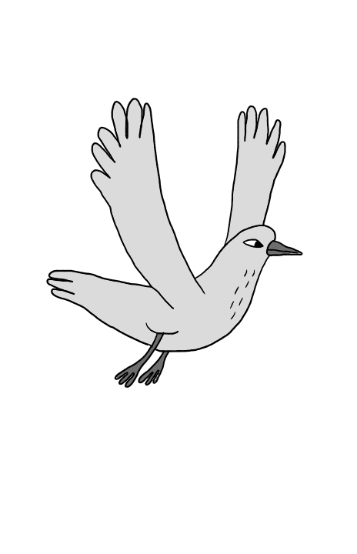
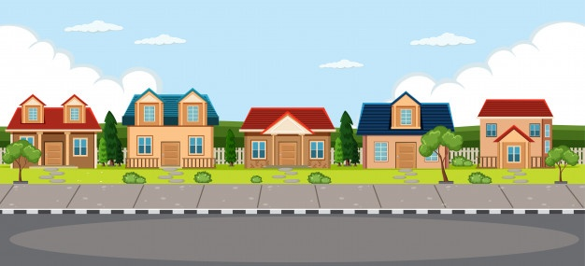
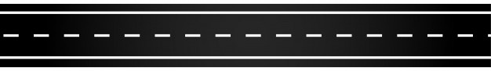
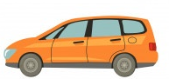

Slide 4

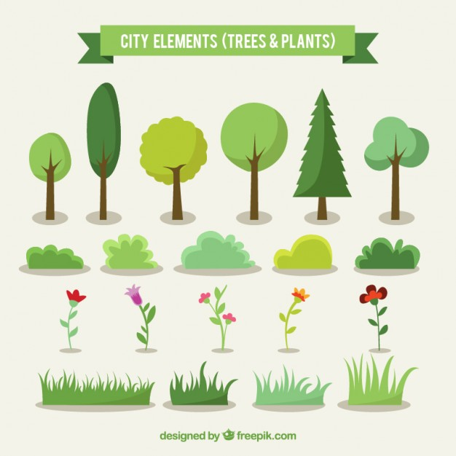

Slide 5
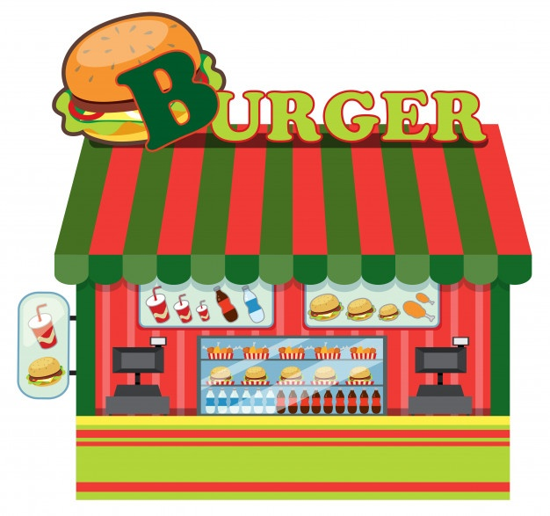
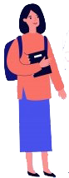
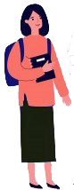


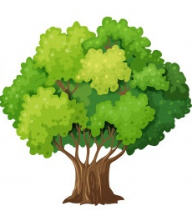
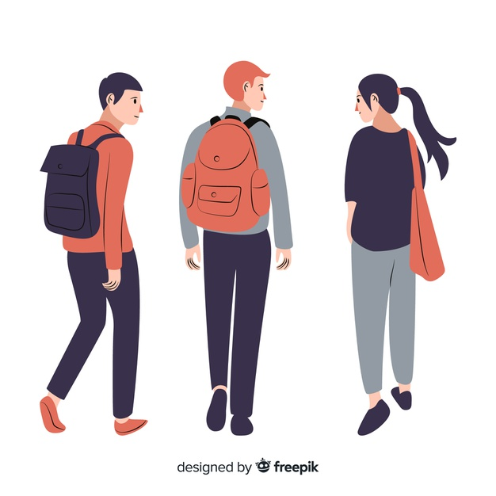





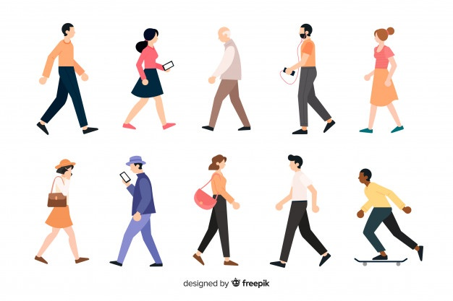



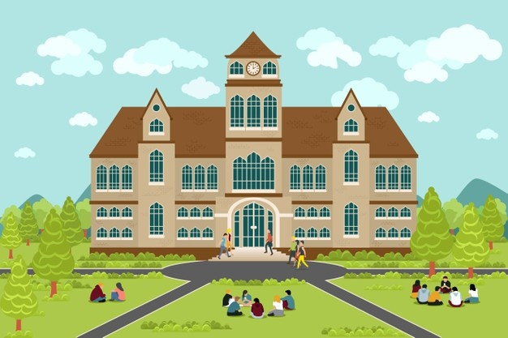
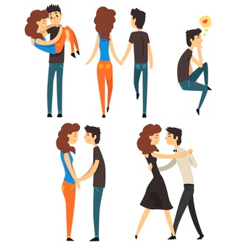
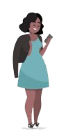
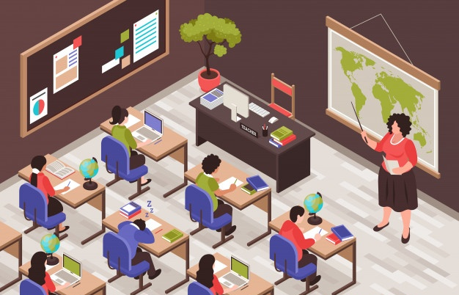



Slide 6





Slide 7

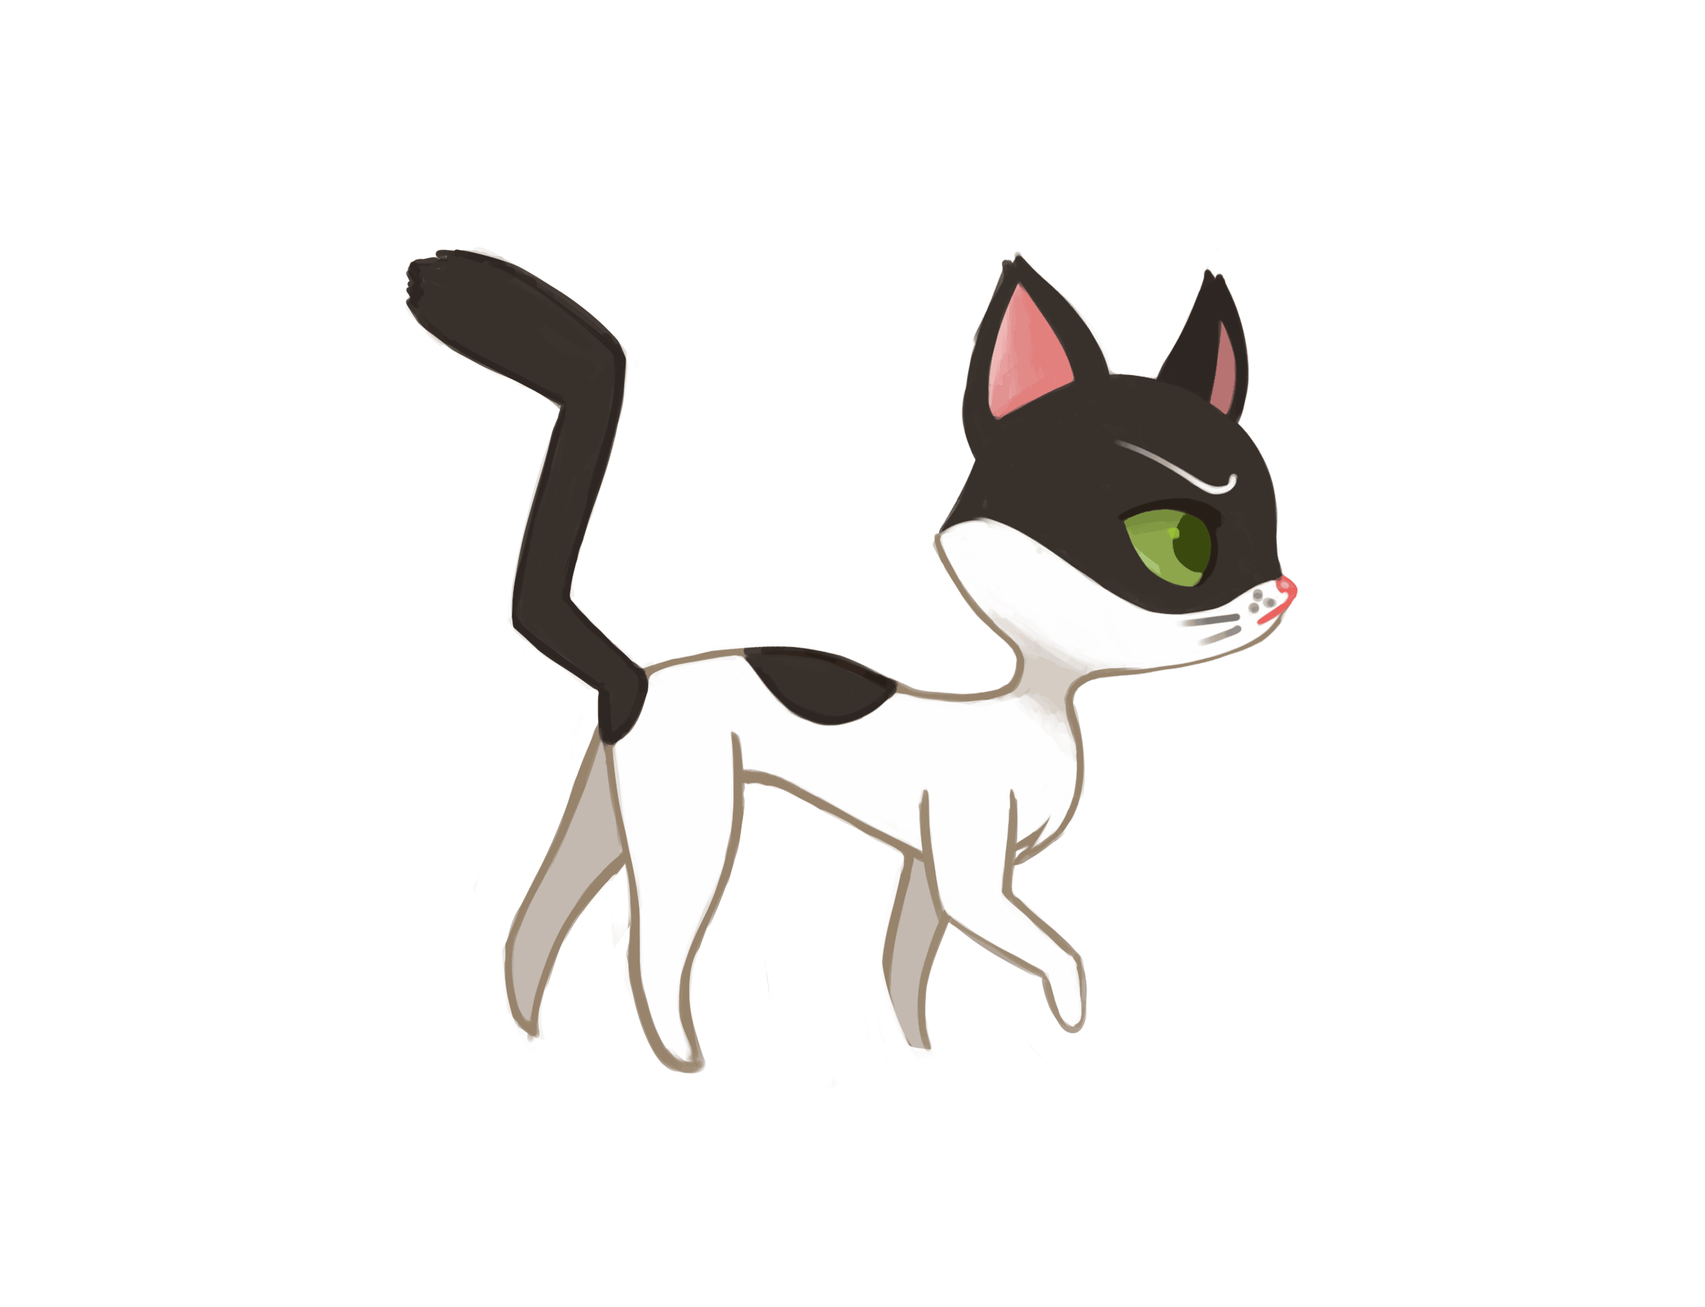

Slide 8
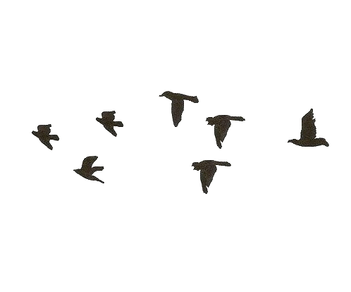


Slide 9
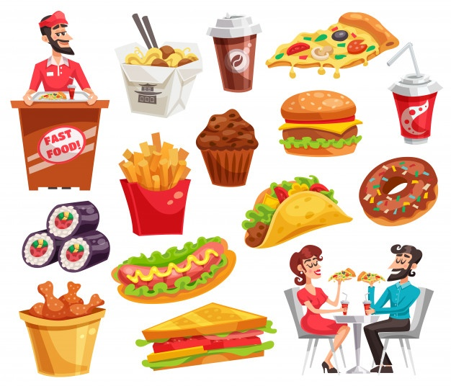

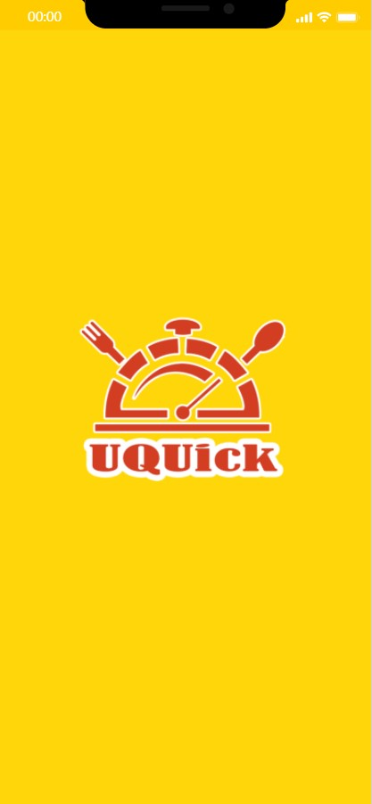

Slide 10
Project idea
The idea of this project is to design an application that can serve order and collection service only from the cafeterias and restaurants of the university.
The application promises to solve the following problems:
Reduce congestion at the university's cafeterias.
Reduce waiting times
Allow customers to keep up with special offers

Slide 11
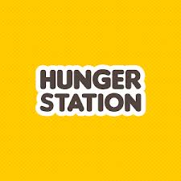


Existing systems
HungerStation
Talabat
Maestro pizza

Slide 12



Problems in the existing Application :
The above applications do not provide ordering from restaurants and cafeterias within the university.
When ordering from these application the order will arrive cold or late.
Some restaurants place restrictions on the application by setting a minimum price for the delivery.

Slide 13



System requirements
Project stakeholders
Customers
Restaurants
Admin

Slide 14

Functional and data requirements
Requirements for the system
Requirements for the customer
Requirements for the admin
Requirements for the restaurant

Slide 15
Non-Functional Requirements
Look and feel requirements
Usability requirements
Performance requirement
Access control
Availability
Extensibility
Authorization
Security

Slide 16
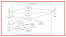
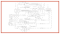
Data Flow Diagram
Data flow diagrams are used to graphically represent the flow of data in a business information system“
01
Use-Case Diagram and Use-Case Scenarios:
A use case diagram is the primary form of system requirements for new software under development
03
Sequence Diagram
“Sequence Diagrams are interaction diagrams that detail how operations are carried out. They capture the interaction between objects in the context of a collaboration“
02

Slide 17
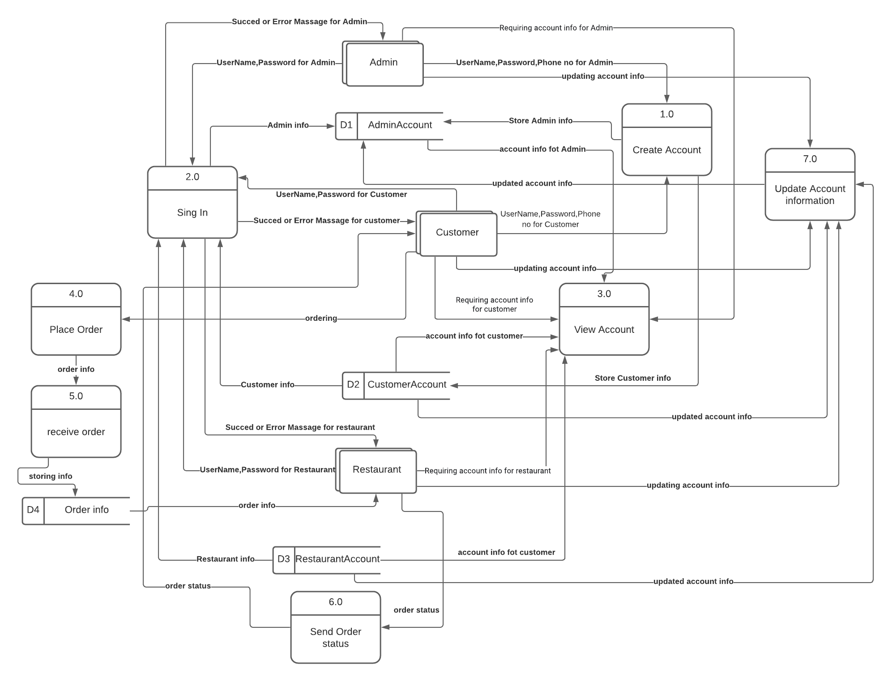

Slide 18
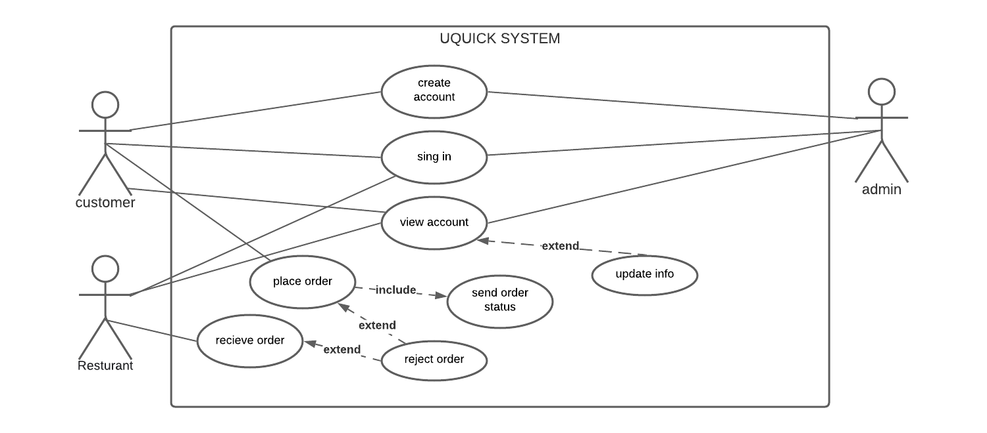

Slide 19


Proposed solution and Alternative solutions
The application is used to help restaurants
The application is used to help customers
To choose from available restaurants and order from them.
To view order status and pick-up the order when it becomes ready.
To receive the orders and respond to them.
Help the restaurants to show their menus and food prices.
It is possible to view the offers provided by restaurants.

Slide 20
Design constraints
Hardware environment:
Android smart phone.
IOS smart phone.
software environment:
Software: Flutter framework
Dart programming language
Database: Firebase

Slide 21
Architectural Strategies
Reuse of existing software components
01
02
Search algorithm
Sort algorithm
03
04
Hash algorithm
Collaborative filtering algorithm.

Slide 22
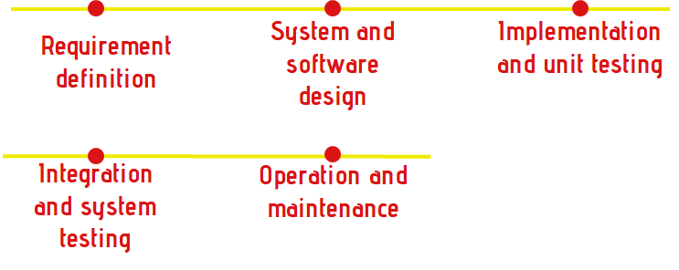
Development method
•The application will be developed using waterfall method.
•it has five phases, each phase must be completed before starting the next phase.

Slide 23

Conclusion
the idea of the project
a background about previous projects with similar idea including: HungerStation, Talabat and Maestro pizza . how the idea was developed and the objectives of our project
system architecture and design including UML diagrams, Data Flow Diagram, Use-case diagram, and sequence diagrams
the programming language that will be used in developing the application is Dart language and it will be developed in android studio IDE using flutter framework.
the application will work on IOS and Android systems.

Slide 24
01 Delivery service so that there will be delegates to deliver orders inside the university.
02 Providing more payment methods such as pre-paying by credit card in order to provide more flexibility in the payment process.
Future enhancements/plans Among the future improvements to the project that we aspire to accomplish:
03 Verifying user's identity by sending a verification code to user's mobile phone number.
04 Serve all the types of stores and stationaries of the university.

Slide 25
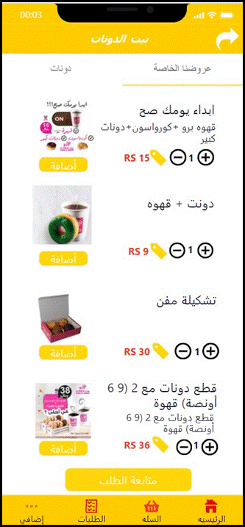
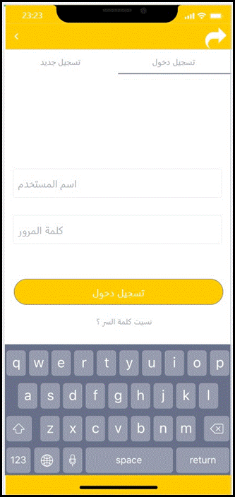
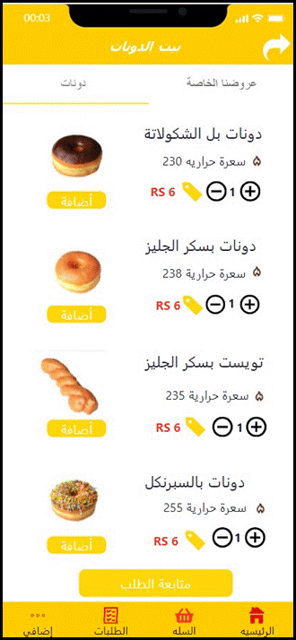
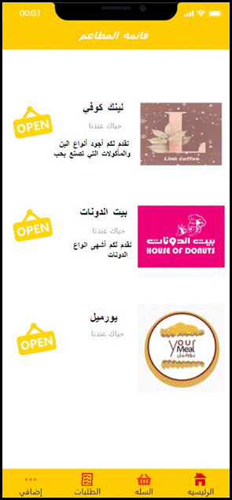
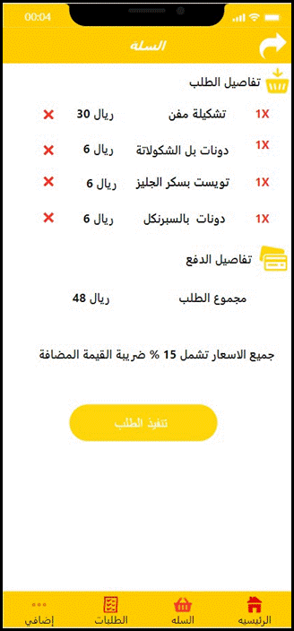
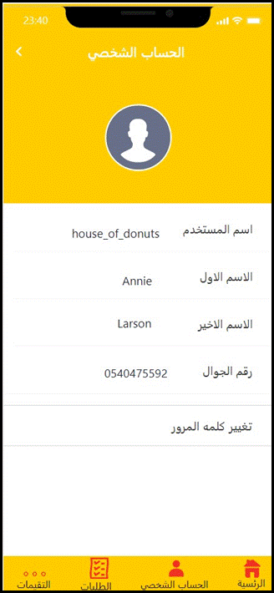
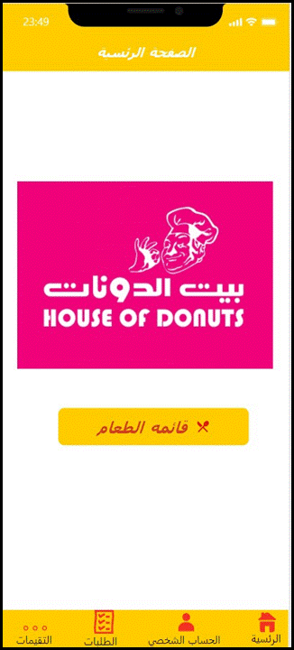
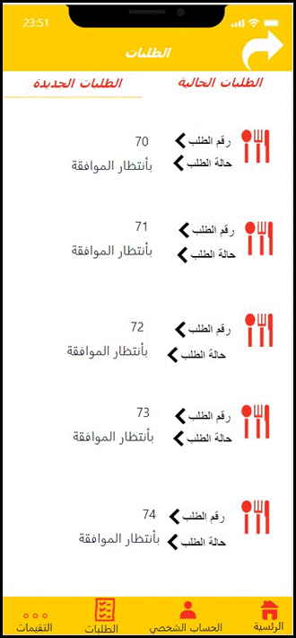
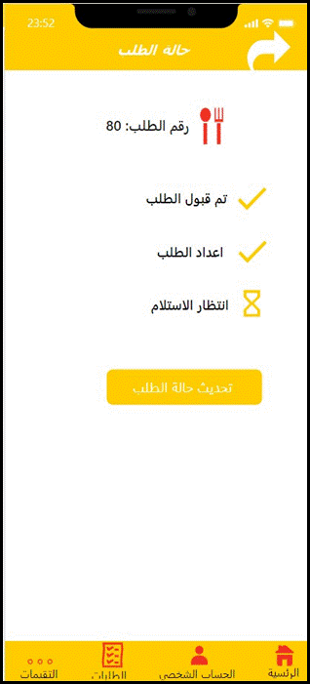
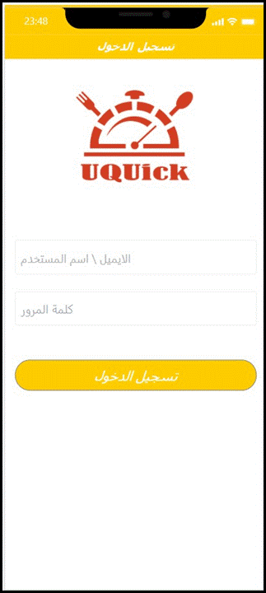
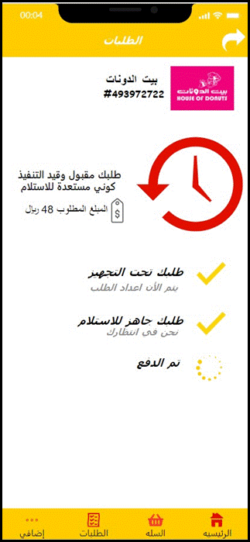
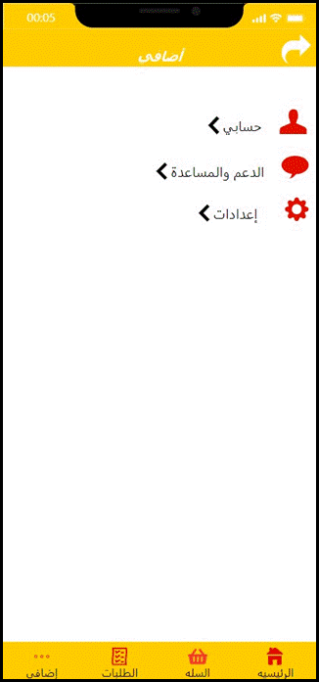
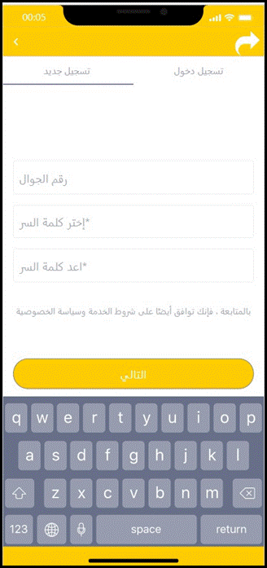
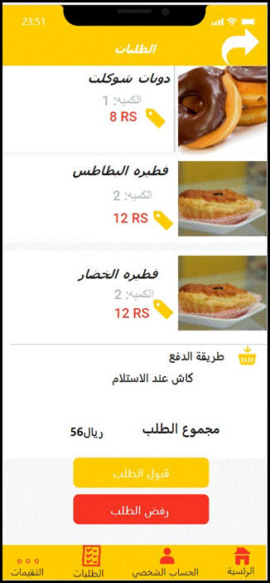

Prototype
Customer interfaces
Restaurant interfaces

Slide 26
Thanks!

